Slide 1
OS & SYSTEMS PROGRAMMING · 25CS2104E
Kernel Monitoring
System
A Linux-based tool for observing kernel resource management, process behaviour, and system-level activity in real time.
Section 5 · Team Root Access
2026–27, Term I
CPU / MEM ACTIVITY
Aman
Sreshta
Pragnya
25200300190
25200300217
2520030238

Slide 2
ABSTRACT
Watching the kernel work
The Linux kernel manages every process, and every unit of CPU, memory and I/O on the system. This project builds a monitoring tool that surfaces that activity — running processes, PIDs, CPU load, memory footprint and process state — in a clear, readable form.
WHAT IT TRACKS
Process ID (PID)
It is built directly on system programming concepts, giving a practical, hands-on view of how applications interact with the kernel — and how the kernel, in turn, manages the machine.
Process state
CPU utilisation
Memory usage
System-level process activityt
KERNEL MONITORING SYSTEM
2

Slide 3
PROBLEM STATEMENT
What's hard to see today
Modern systems run many processes at once, each competing for CPU and memory. For students learning Operating Systems especially, it's difficult to see what's happening inside the kernel and how those resources are actually being managed.
PROJECT FOCUS
Kernel-level resource management
Process monitoring
THE GOAL
Build a Linux-based tool that collects and displays system and process information clearly — turning kernel-level resource management into something observable, not hidden.
System programming mechanisms
KERNEL MONITORING SYSTEM
3

Slide 4
OBJECTIVES
What the system sets out to do
1
Monitor processes
2
Observe resource management
Monitor running processes by displaying their PID, PPID, process state and name
Monitor CPU load averages and memory information, including total, available and used memory.
3
Use native Linux interfaces
4
Present it clearly
Collect data via Linux system calls, POSIX APIs and system-level interfaces.
Provide a simple, understandable interface for viewing kernel and process activity.
KERNEL MONITORING SYSTEM
4

Slide 5
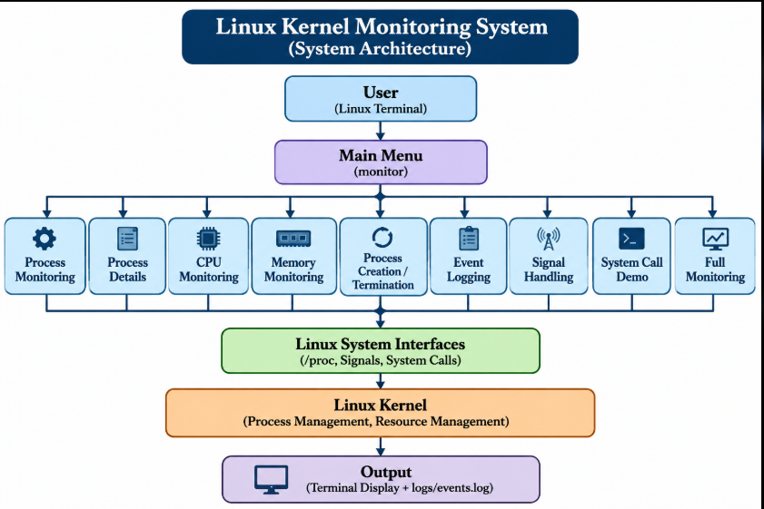

Slide 6
OS CONCEPTS & LINUX APIS
Grounded in core OS theory
The project puts textbook Operating Systems concepts into practice, using real Linux system-level interfaces to read live kernel data.
1
2
3
Process Management
Memory Management
CPU Load Monitoring.
Creation, scheduling and state transitions of processes
How the kernel allocates and tracks memory per process
Measuring load and time share across running processes
4
5
6
System Calls
Process States
Resource Monitoring
The interface applications use to request kernel services
Running, sleeping, waiting, stopped and zombie states
Continuous observation of system-wide resource use
KERNEL MONITORING SYSTEM
6

Slide 7
TOOLS & PLATFORMS
Built with
Ubuntu / Linux
C / C++
POSIX APIs
Development & execution environment
System programming language
Standard system-level interfaces
Linux System Calls
/proc filesystem
GitHub
Kernel-level data access
Live process & resource data
Version control & collaboration
KERNEL MONITORING SYSTEM
7

Slide 8
EXPECTED OUTCOME
What the tool will deliver
A working Linux-based monitoring tool that makes kernel and process behaviour visible and understandable.
Display Process ID (PID) and process state
Monitor live CPU utilization
Monitor live memory utilization
List information on all running processes
Detect process creation and termination.
Record detected process events in a log file.
Build understanding of kernel & process management
Demonstrate practical Linux system programming
KERNEL MONITORING SYSTEM
8

Slide 9
Thank You
Root Acess
Questions & discussion welcome.
Section 05 · Team

